Slide 1

AI for Redshift Prediction
Sam Knisely, Darreion Bailey

Slide 2
Agenda
1.
Introduction
2.
Data & Methods
3.
Benchmarking
4.
Results

Slide 3
Agenda
1.
Introduction
2.
Data & Methods
3.
Benchmarking
4.
Next Steps

Slide 4
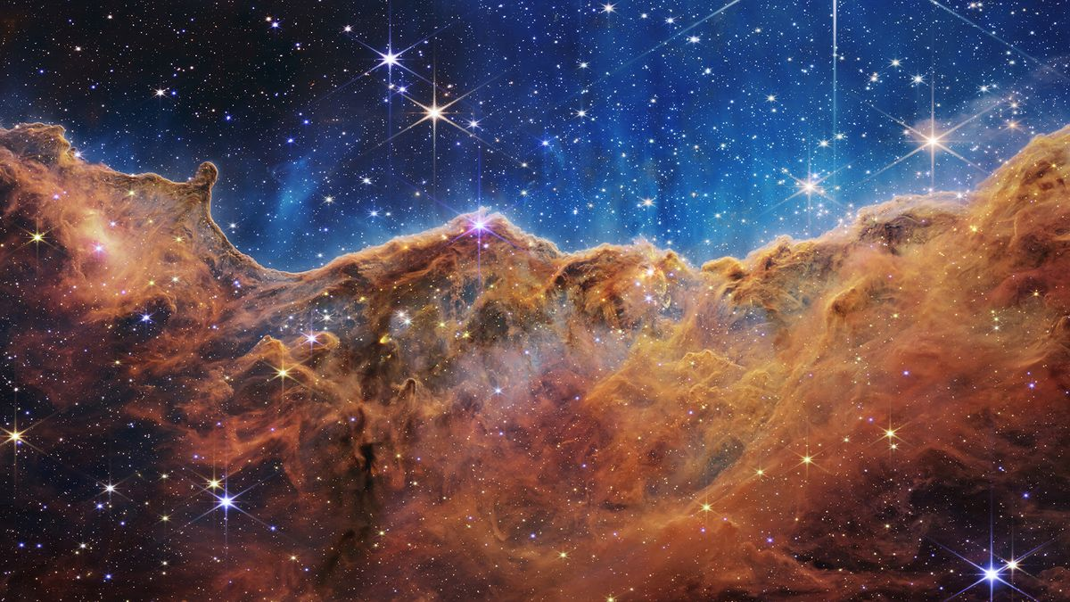
Introduction
Introduction
We utilized the over 12GB of space images to predict Redshift expansion of the universe.
Various model specifications were tested to evaluate performance and cost.

Slide 5
Agenda
1.
Introduction
2.
Data & Methods
3.
Benchmarking
4.
Results

Slide 6
Data & Methods
Data Structure
12.6 GB of data stored as a PyTorch TensorDataset object.
Data Partitions: 25MB, 50MB, 75MB, 100MB
Saved to team4-cosmical S3 bucket.

Slide 7
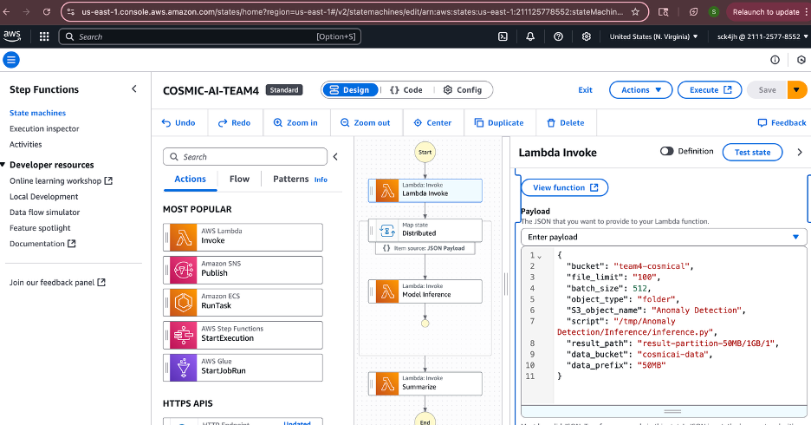
Data & Methods
AWS Step Function
Manages interaction of FaaS Message Interface (FMI) lambda functions.
Three lambda functions: Invoke, Inference, and Summarize

Slide 8
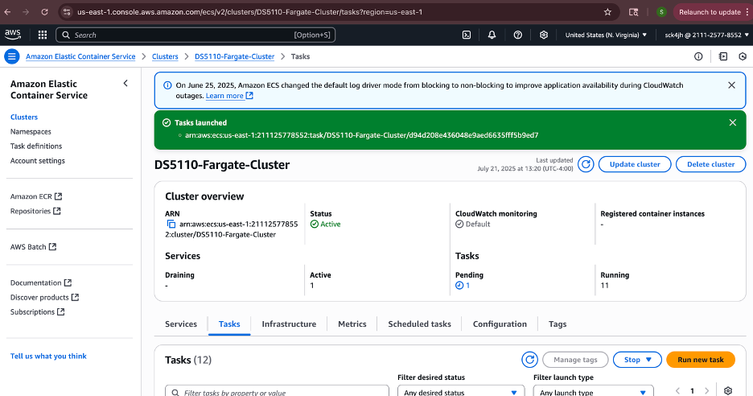
Data & Methods
Rendezvous Server
Help distributed worker nodes (e.g., GPUs) find each other and form a communication group before training starts.
Enables distributed ML training.

Slide 9
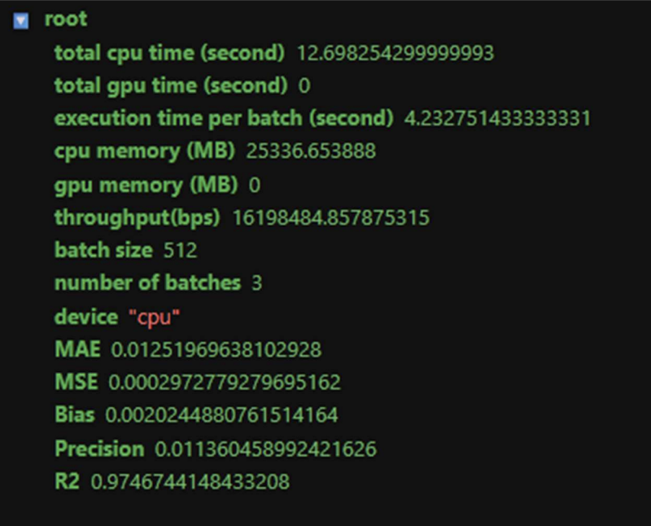
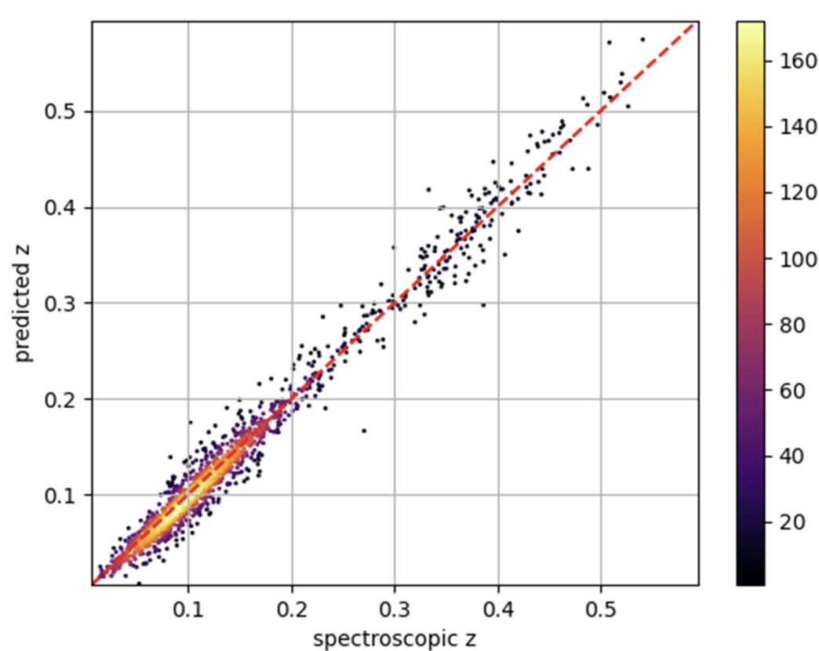
Data & Methods
Astronomy Inference
Ran inference (inference.py) locally on preprocessed astronomy datasets to predict redshift values.
Predicted values closely match actual values.

Slide 10
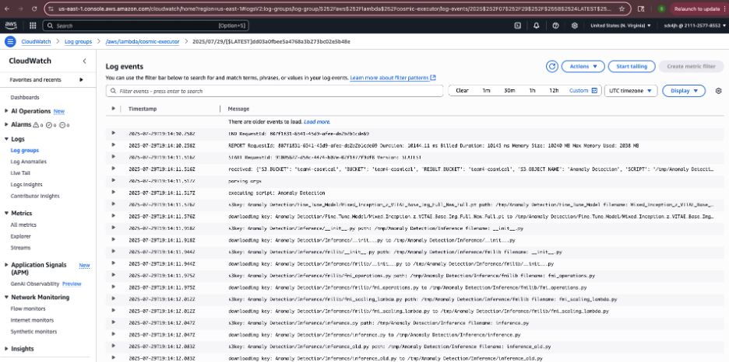
Data & Methods
Cosmic AI with Lambda FMI
End-to-end AI workflow combining PyTorch inference, FMI, and AWS.
Parallel inference using varying data partitions, batch sizes, and dataset sizes tested.

Slide 11
Agenda
1.
Introduction
2.
Data & Methods
3.
Benchmarking
4.
Results

Slide 12
Benchmarking
Benchmarking
Compare local vs AWS execution.
Evaluate batch size across a baseline scenario.
Results measure cost and performance on varying data partitions, data sizes, and batch sizes.

Slide 13
Local vs AWS Execution
Benchmarking
Metric | Local Execution | AWS Execution | Notes
Execution Time/Batch (s) | 4.23 | 2.46 | AWS ~42% faster
Throughput (Mbps) | 161.98 | 34.44 | Local ~4.7x higher
CPU Time (s) | ~12.7 | ~12.5 | AWS slightly better
Memory (MB) | ~25337 | ~3762 | AWS ~85% less memory
Sample/sec (normalized) | ~121 | ~211 | AWS ~75% faster

Slide 14
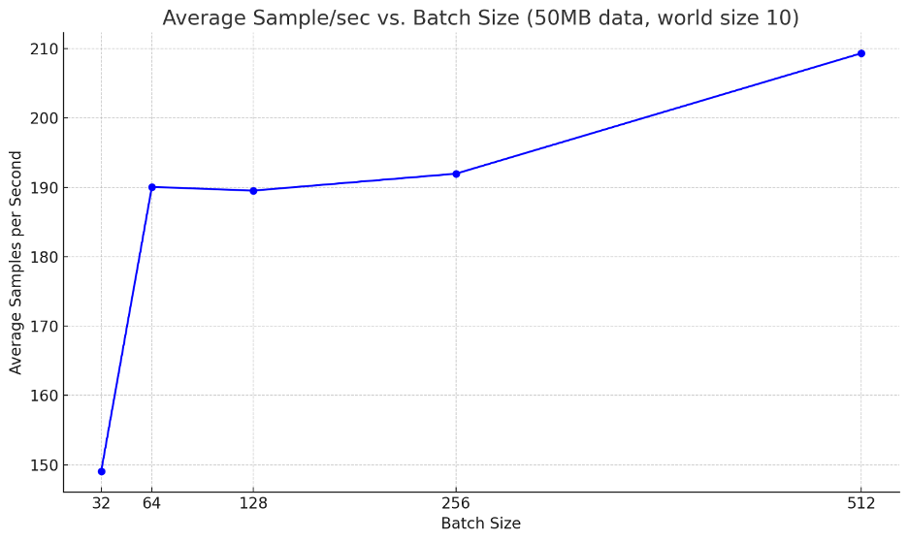
Batch Size Benchmarking
Benchmarking

Slide 15
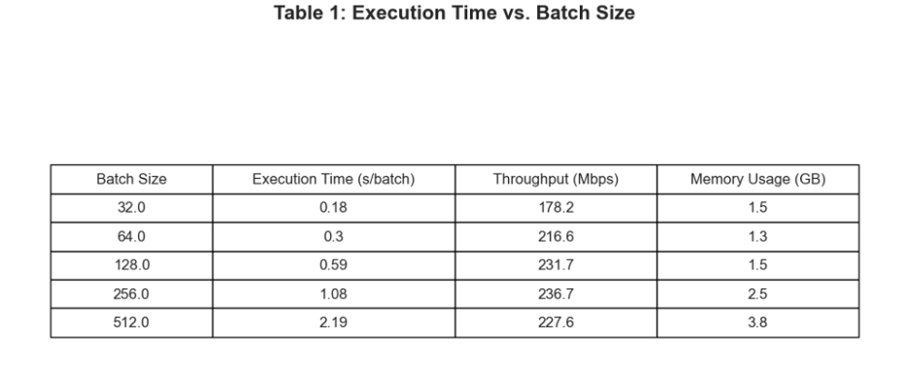
Batch Size Benchmarking
Benchmarking

Slide 16
Agenda
1.
Introduction
2.
Data & Methods
3.
Benchmarking
4.
Results

Slide 17
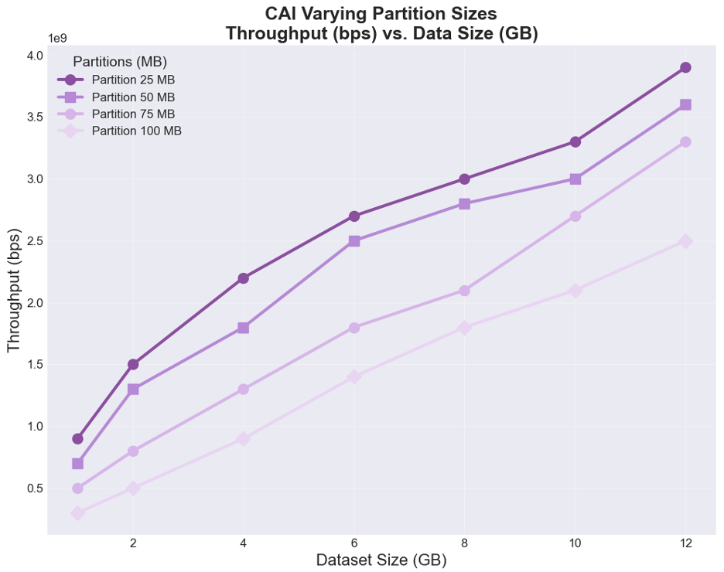
Data Size Throughput Performance
Results

Slide 18
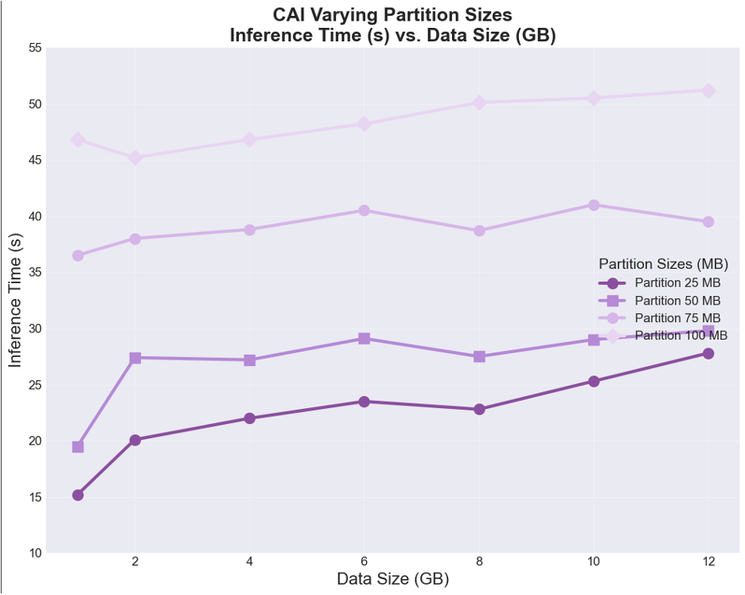
Results
Data Size Inference Time Performance

Slide 19
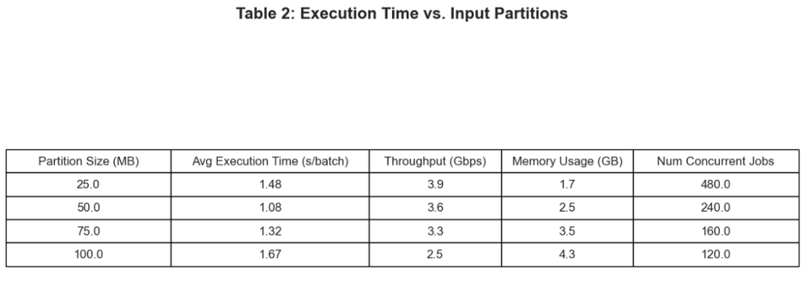
Execution Time Across Data Sizes
Results

Slide 20
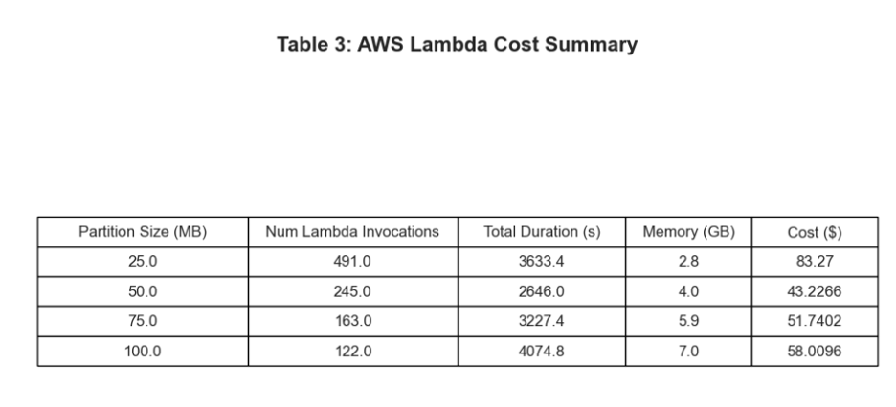
Results
AWS Lambda Cost Summary

Slide 21
Results
Cost Insights
1. Smaller partitions (25MB) have more parallel invocations but lower memory requirements
2. Larger partitions (100MB) have fewer invocations but require more memory
3. The 50MB partition offers a good balance between parallelism and resource usage
4. Cost increases roughly linearly with dataset size for all partition sizes

Slide 22
Results
Conclusions
The results showed that running CosmicAI on serverless infrastructure was significantly faster
and more efficient than running it locally. Inference time dropped from 4.23 seconds to 2.46
seconds, throughput increased by about 75%, and memory usage dropped by over 80%. The
main bottleneck in the serverless setup was reading data from S3, which was slower than reading
from local disk. The most efficient setup used 50 MB data chunks, which balanced speed,
memory use, and cost well. Smaller chunks caused too much overhead, while larger chunks
slowed down processing. Overall, cost scaled predictably with dataset size, making it easy to
estimate expenses at scale. The results confirmed that serverless is a strong solution for scaling
CosmicAI, with the only major limitation being cloud storage speed.

